Slide 1

Clinical Decision Making and Pattern Recognition
Understanding how AI can be used in predictive models and pattern recognition to support the decision-making process

Slide 2
What it means
Decision-making:
Removing some of the human burden of making choices
Pattern Recognition:
Finding similarities within the data and making conclusions based off that
Create models to train on past data and predict future outcomes
Use models to figure out the best treatment plan for patients
Decrease decision-making workload on clinicians and patients
Use time-series clustering to make accurate inferences
Integrate unsupervised models to find anomalies in data
Decrease the time spent by physicians to find problems within the data

Slide 3
Decision-making and AI
Predictive modeling
Generative AI (GenAI)
Using testing and training healthcare data to predict the best treatment, plan, or decision
Agentic AI
Creates outputs by predicting what the most likely outcome of a certain prompt is
A multistep system that can plan, analyze, reassess without needing human intervention

Slide 4
Pattern Recognition in Healthcare
Time Series Clustering
Using time-specific data points to cluster data into groups
Inferential Unsupervised Data
Making models that recognize patterns without having an output variable to train from
Find Inconsistencies in Data
Finding anomalies in the continuous stream of clinical data to provide time-sensitive care

Slide 5
1.
Predictive models for Decision-making
Implementation at Cotiviti
Can use models to categorize patients based on health risk and predict best treatment plan
1. A.
Agentic AI
Agentic AI can run a loop of analysis, execution, and reevaluation to decrease human intervention
2.
Inference using Pattern Recognition
Pattern recognition to cluster patients into different treatment plans

Slide 6
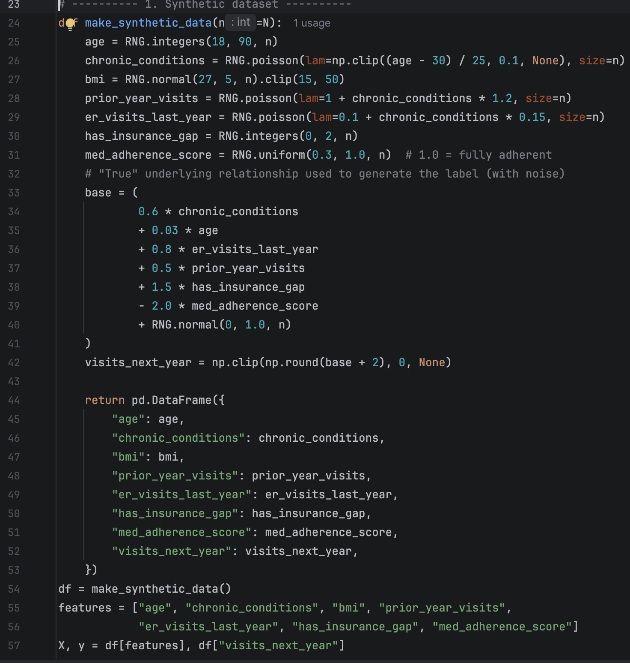
Proof of Concept
Finding the best healthcare plan based on medical history and insurance

Slide 7
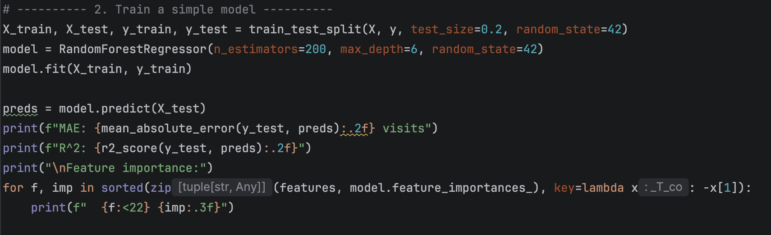
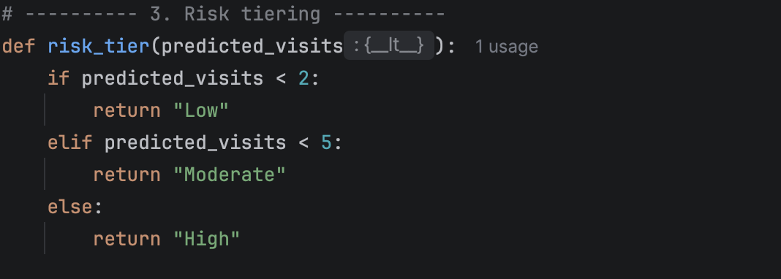
Proof of Concept cont.
AI solution evaluation
Vendor assessment and selection
Pilot project development
Small-scale implementations prove value before larger investments

Slide 8
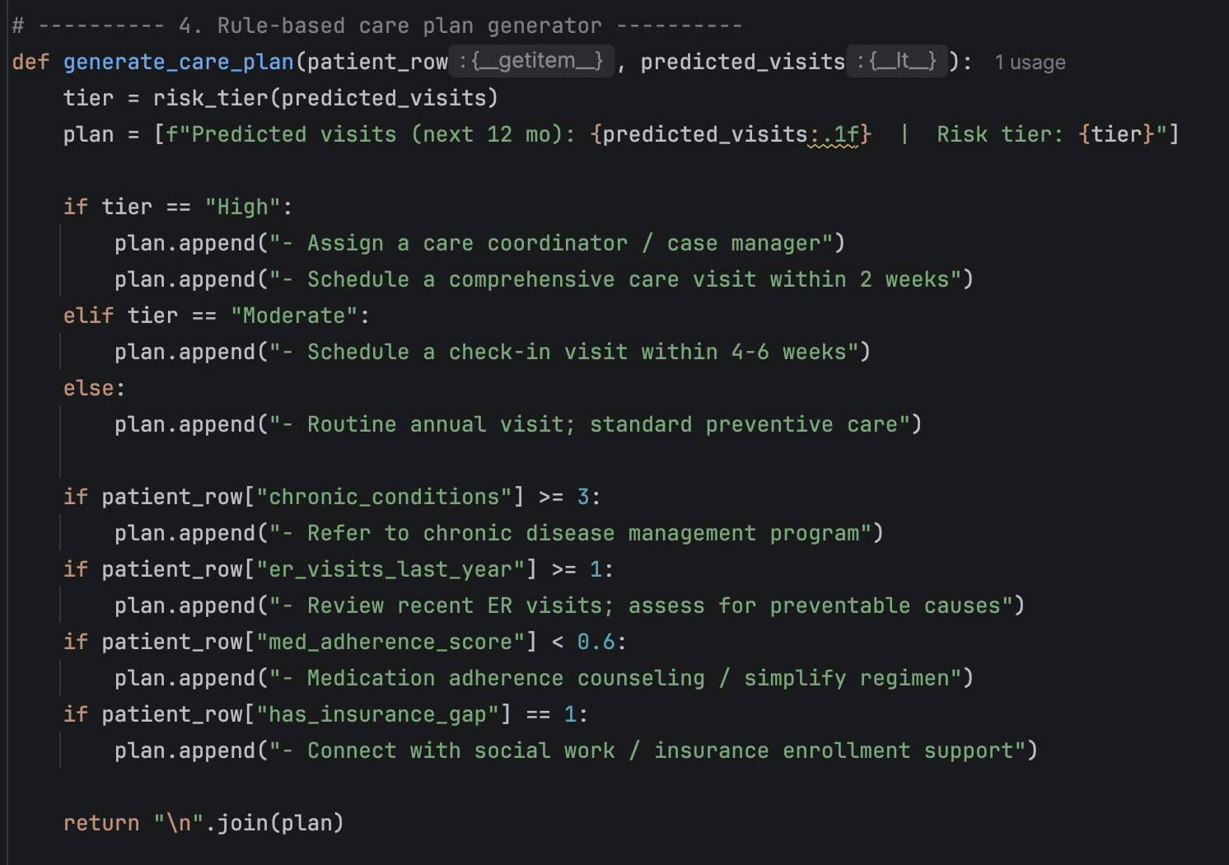
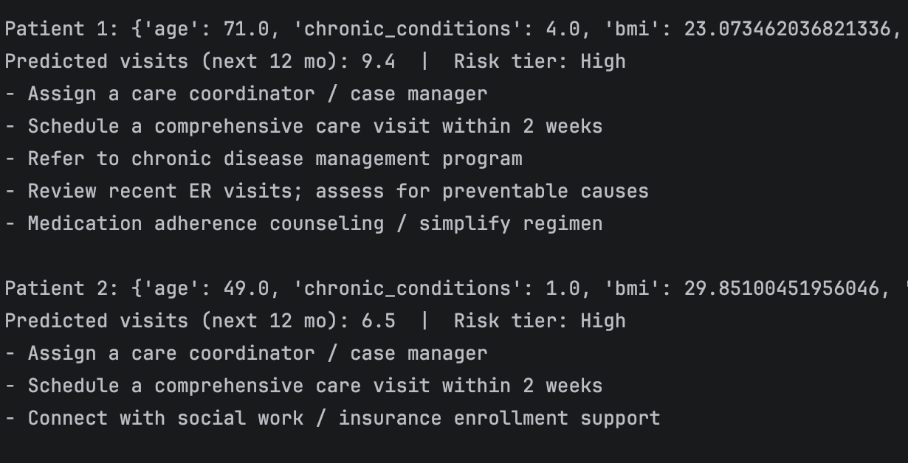
Proof of Concept cont.
Example Output:

Slide 9
AI solution evaluation
Conclusion
Decision-making and pattern recognition in healthcare can be automated using AI to help support clinical workload.
AI technology continues to develop, and predictive and inferential models are some ways to take advantage of that development in Healthcare.

